Slide 1
Codewords
Product Design Hypotheses
Agemo x Joyus

Slide 2
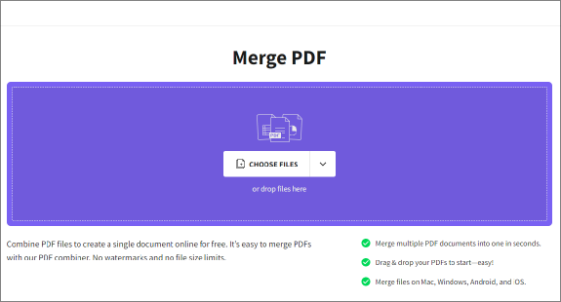
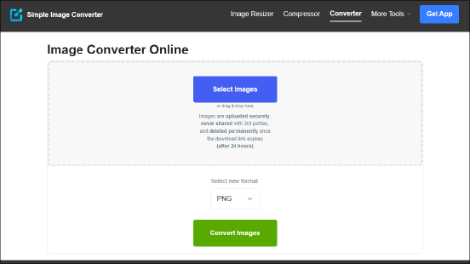

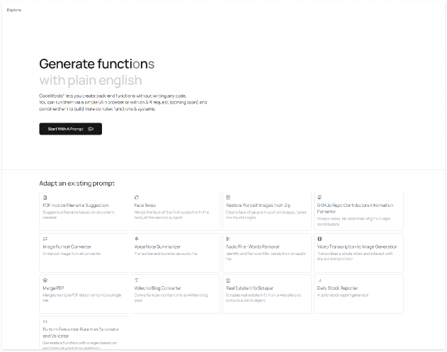
1 : Codewords requires a behavior change
We are introducing a new way of completing an existing behavior to users, not a new behavior
There are a variety of existing tools that are one google search away, and users are already using those. We are creating behavior change from an existing pattern for our users.
How to test :
If users are abandoning to check google part way (e.g., longer than expected times to completion/ post build abandonment)
Tracking cross function usage, are users who are coming in for one function branching into others?
  If without completing initial task may be indicative of low intent but higher curiosity
  If post completion then behaviour change is happening
  If no cross usage then the 30 Day retention will be very low
Notes:
Today there is an existing way of solving the types of issues that could be solved with codewords.

Slide 3
2: There’s a journey to adoption
Codewords is a complex product and users will need to see how codewords works in their context for adoption, which will require more than one visit.
We think mindsets will follow as per the diagram.
We believe that new users will not be prepared to create from a blank prompt at first
How to test
visit number for first usage / creation / where creation / usage of function is occurring (remix/ home page/ function page/etc)
  if hypothesis hold true, we would expect to see users having a longer adoption cycle (pages/visits) to habitually get to blank prompt creation
Creates Solution This is where the user is either
evangelist
familiar with 70%+ features
creating functions for fun
has codewords as a part of their pipeline
Learn Capabilities Starts off on marketing/starting page
Refines Need Explore / Remix pages???
Pre discovery
“How do I ....” ”Can I use a tool to let me ...”
“Can I find something similar to help me with the problem I have now”
“Does this work for ...”
“It’s cool this can do ...”
“I wonder if this could apply for my ...”
“Could this integrate or replace my existing ...”
“Can I try this for a something simple ...”
“Can I trust this to be consistent for...”
“How can this fit into my workflow for ...”
“How can I modernize this existing workflow with ...”
“How can I make this function into something I can integrate in ...:
Users’ “State of Mind”

Slide 4
3: Intent > Curiosity
Favor people who have a goal to complete, and secondarily support people who are curious or idly browsing
How to test:
Mastery is hard to measure in short term but you can check via
a) time spent using codewords (mastery products tend to have higher time spent in single session overtime)
b) complexity of functions people are designing using codewords
what percentage are moving from using codewords functions to make more complex functions
number of blocks in function graph
Note : while the team wants to build a product for the power user, it is valuable to see if this hypothesis holds true, if that is the behaviour we are seeing, and if we want to design for it, and it isnt happening, how can we change the design of the product to make that more successful.
Codewords is a mastery oriented product, we want to design our workflows according to that.

Slide 5
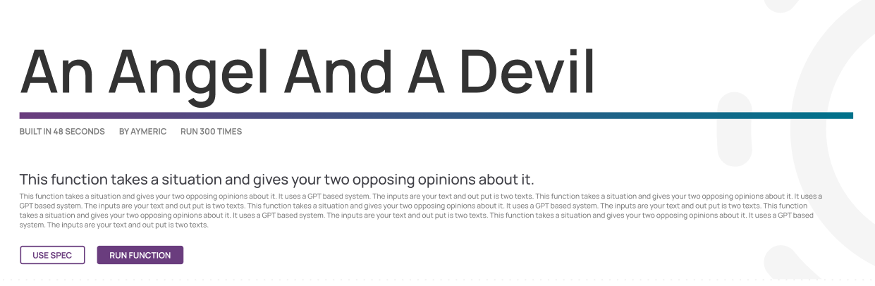
4 : Completeness over Simplicity
How to test:
are we getting power users?
  are users going for more complete or more simple functions when they are effectively the same (e.g., less / more clear descriptions)
are users leveraging functionalities meant for power users?
  are they looking for information
    architect
    FAQ
    spec
  are they finding what they are looking for
    architect interaction
    time spent / path after FAQ / spec
Favor enabling power users over simplifying for casual users.
Codewords is complex and powerful, we fully intend to design for power users, and enable them learning the depths of the tool.
eg. Giving description, detailed description, directly letting user see spec link etc. despite it being more information dense as a design solution
Notes:
No Blackboxes

Slide 6
5: Defer to the human
How to test:
What percentage users accept the AI made prompts directly?
  How is this behaviour evolving over the life cycle of user? Are they more or less likely to make changes to the spec as time passes.
  do they seem satisfied with them? (do they send more queries after / do they redo the prompt / do they end up remixing the prompt or starting again when they select AI prompted refines, and what percentage)
are users being able to complete their tasks?
  tasks:
    completion of new function creation
    usage of functions
  components
    amount of AI assistance
    type of interaction (asking for details, etc.)
We will look to the user for confirmation on the AI’s work
This is a hypothesis that the codewords team came with, that users will know what they want, the user knows how to solve problems and our job is to be a tool in their toolset, not tell them what to do.
Notes:
No Blackboxes

Slide 7
6: Draft state matters
How to test:
are users making more than one version of the function?
  are they making changes to the prompts / refining with architect and then making the function (this would indicate they are refining the function for the same purpose)
are they dropping off without using the function or using for what seems only a test use case
  this would indicate they are not being able to make a function that met their specifications(so average function run count should be >1 on non error functions)
are they asking questions to the architect that indicate refinement?
  can we get a report from the architect on the sentiment of queries that were put to it? (e.g., refinement, clarifying, explanatory, etc.)
Ideas rarely show up fully formulated. The drafting process necessitates space for feedback and refinement.
What does this “middle step” need to accomplish?
Show the system as accessible
Show the user some sense of why choose to invest time working with the system (e.g., this will be faster/easier to update/more stable/more extensible/etc.)
Built trust through one of a variety of ways:
Show consistent value being added to the user
Let the user feel they have created / found / can show something of value for the time invested
Avoid damaging trust
Losing information / context the user has shared
Doing something that seems illogical
“wasting” the users time
Note, some users may be able to do this very fast - they quickly understand the system capabilities and are able to start thinking about how their needs may be solved. Q:What actions can we give them at that point?
This hypothesis is about having the function creation process as iterative rather than “one and done”. Hence spec and reworking with spec are both given appropriate space.
Aspirational / Hope for Solution / Intent-Based Curiosity
journey question: When and how can this do something for me?
high intent : Problem solving
journey question
What of my problems can be consistently solved by this system
Curiousity
Low intent for product
journey question :
What does this do?

Slide 8
7: Remixing is the new creating
Most new things are adapted from existing solutions in today’s world.
Note: it will be hard to test the execution versus the theory in this iteration.
biases in the data:
default options
button word choice
segmentation in audience (e.g., power users vs casual)
Things to pay attention to:
in what contexts are users using remix versus creating from new prompts (e.g., first visit vs 10th visit, first creation vs. 10th creation, repeated creations in same visit)
when do they remix from their own prompts
  this may give us some signal on how much people are using as a repository for their own thinking
what is success rates (function used, no drop-off) when remix’d prompt versus created prompt
And on a larger scale, AI products are blurring the line between creation and generation, and we want to embrace that ethos.

Slide 9
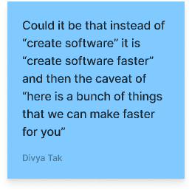
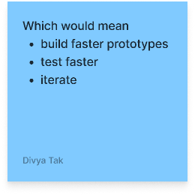
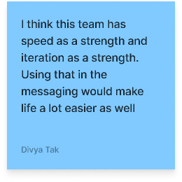
8 : Users want it done
Harder to directly test in this iteration, but we have some areas that can be observed and qualitative inferences can be made
Things to pay attention to:
are we getting the right things done?
are users getting frustrated they can’t intervene when the system gets something wrong?
is the function generated usable in the way that it has been created?
when we give the users an ability to customize, are they using that? are they looking for more abilities to refine then they are finding?
Optimize for giving users something they can use, over getting into the details of how its going to be done
When possible, we try to avoid making the user have to make implementation decisions

